Slide 1



Driving Voter Turnout Using Blockchain:
Digitization and Security, featuring Solidity Smart Contracts
Ryan Claycomb, Pani Maddi, David Frasier, John Hernandez

Slide 2
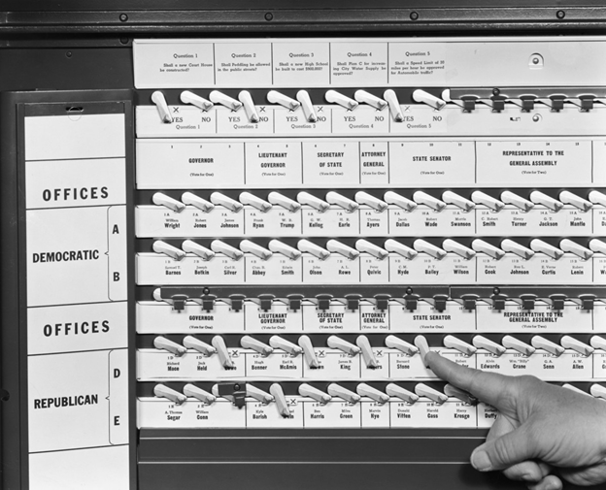
Notes:
First Voting Machines

Slide 3
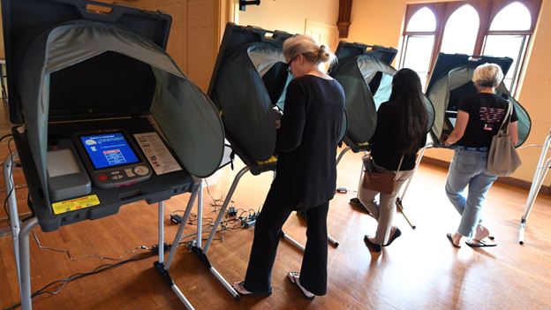

Slide 4
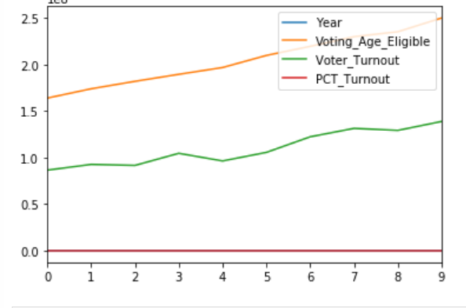

Slide 5
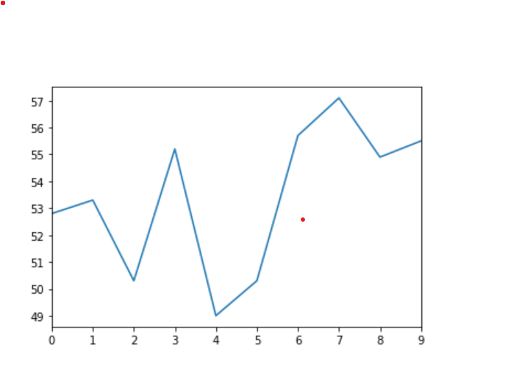

Slide 6
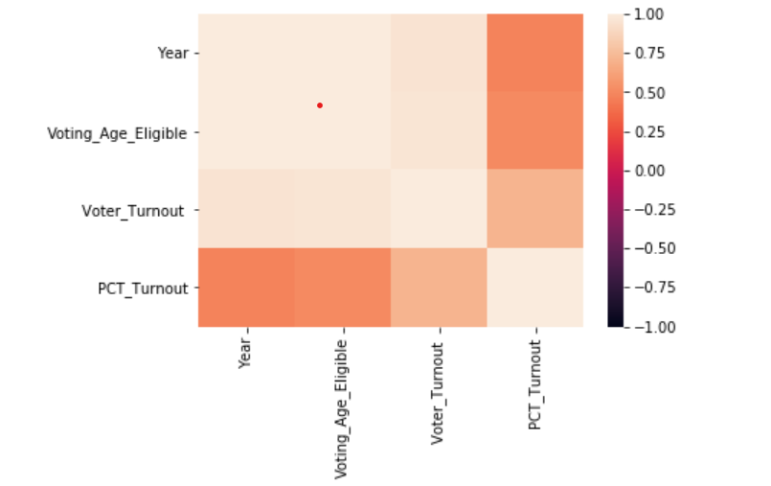

Slide 7
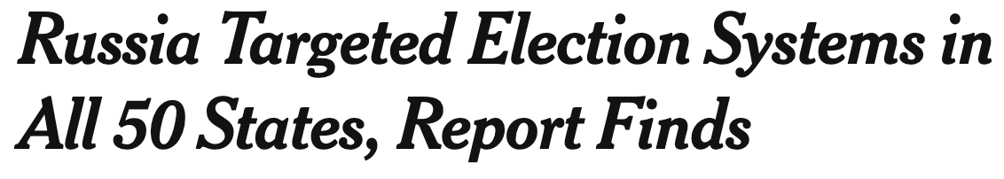
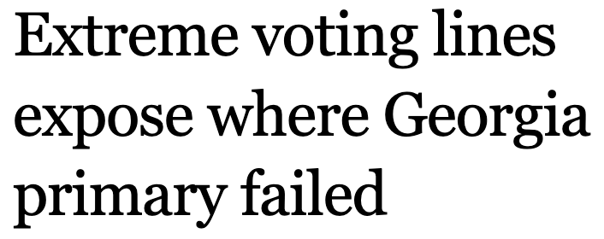
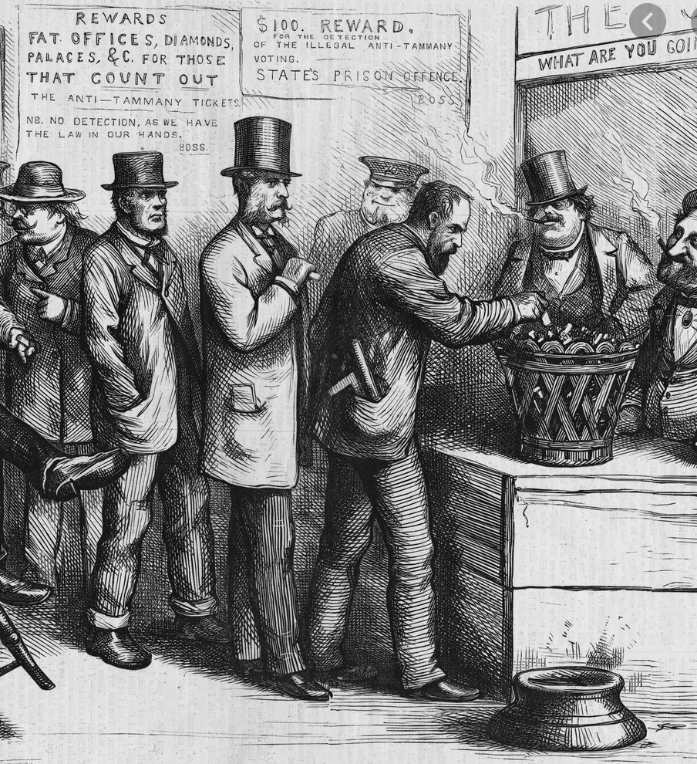
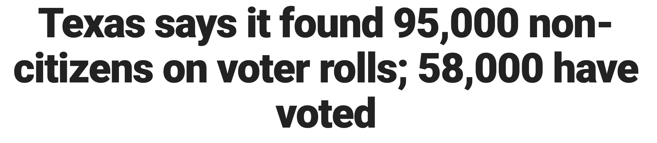

Slide 8
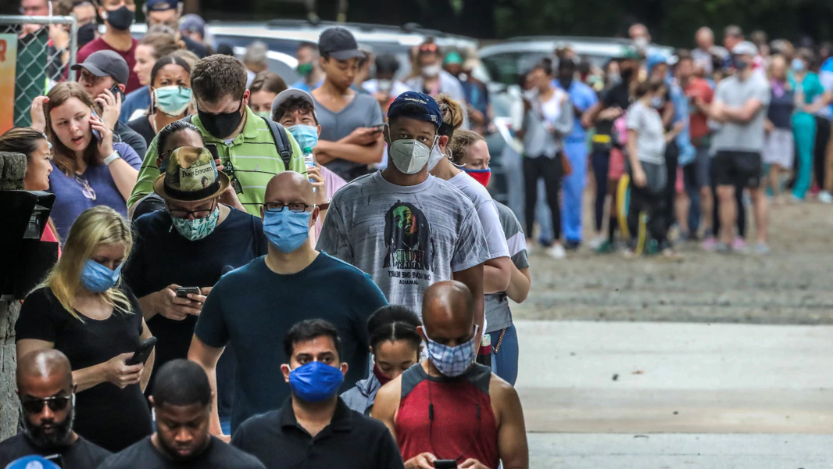
Goals & Methodology
Goal: Drive Voter Turnout
How: Voting Web Dapp w/Solidity
Backend (Remix IDE, Truffle Suite or Faucet)
Front End (NPM, Unbox Pet Shop)
Hosting (Pinata, IPFS)
Election Information (Sample Ballot)
-

Slide 9

Why Change?
Traditional
Manual Work
Known Sunk Cost
Jail, Traveling, Military, Weather, Childcare, Work
Centralized, Legal and Political
Smart Contract Voting
Automation
Gas Cost, Initial Capital
Safer Immediately
Decentralized Identity and Vote Storage
Built for Legality
Dapp, Timestamping, Digital Signatures

Slide 10
Voting Dapp: Demo

Slide 11
Voting DAPP: High Level Process
Ethereum Mining Capacity
Candidate Registration
Voter Registration & Onboarding
Cast Your Ballot
Dashboard & Analytics
Ethereum Capacity Constraints / Bottlenecks
Develop logistics for timely and legal voting
Obtain Candidates
Register Candidates
Obtain Voters
Register Voters
Wallet Setup
Authentication
Vote
Confirmation
API, 3rd Party Integrations

Slide 12
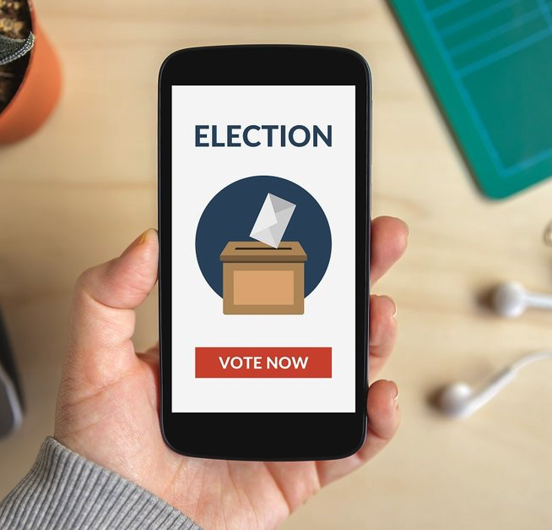
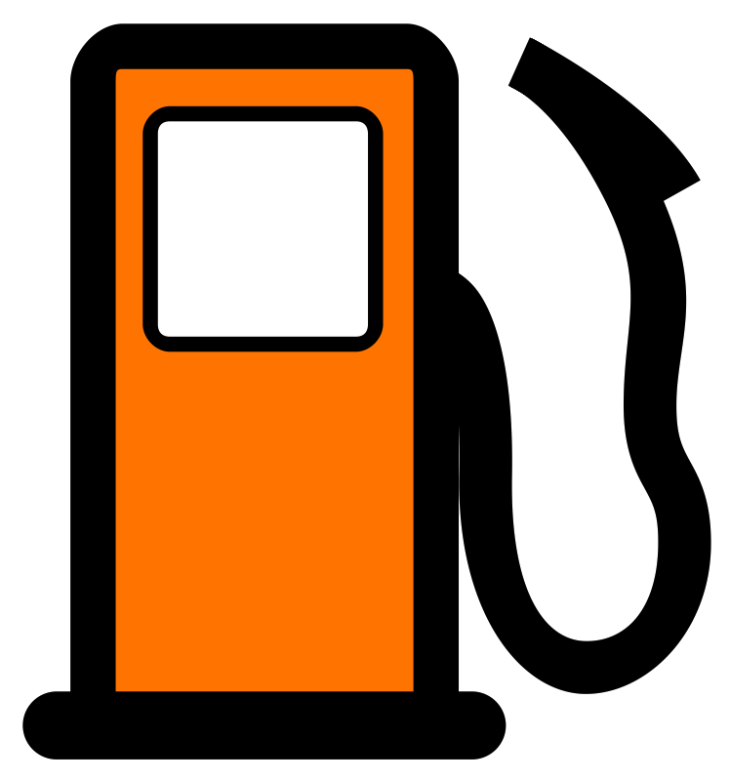
DESIRED VOTE PROCESS - Frictionless process to encourage DAPP voting (drive Voter participation% higher)
Log In (Authenticate)
Vote
Log off
I DON’T WANT TO PAY FOR GAS
SHOW STOPPER?

Slide 13
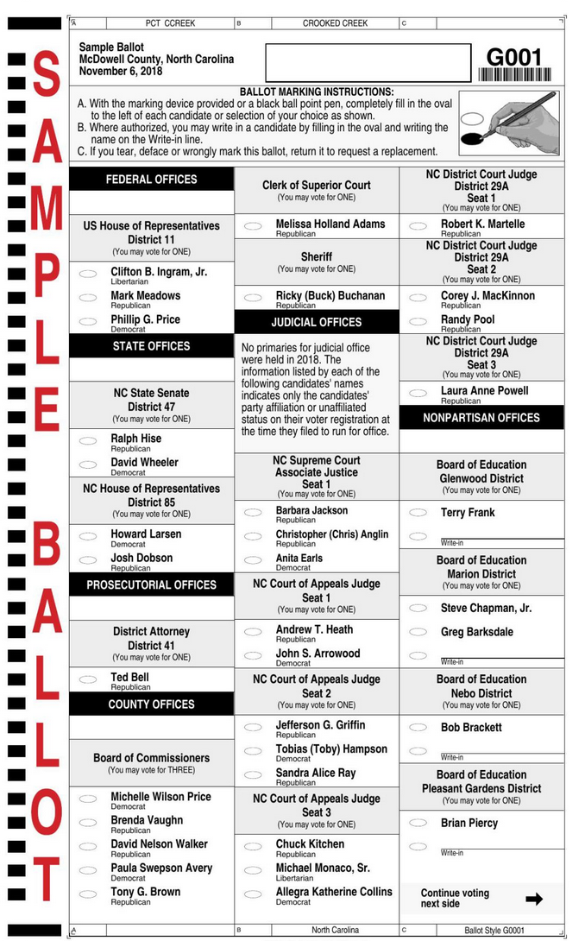
Optimizing Gas
Gas for writing to Ethereum (not for reading)
Use lower cost data elements - ex. bytes32 instead of string
Simple Contracts
Don’t Repeat Yourself (DRY)
Use Modifiers for Checks
Do as little as possible in constructor

Slide 14
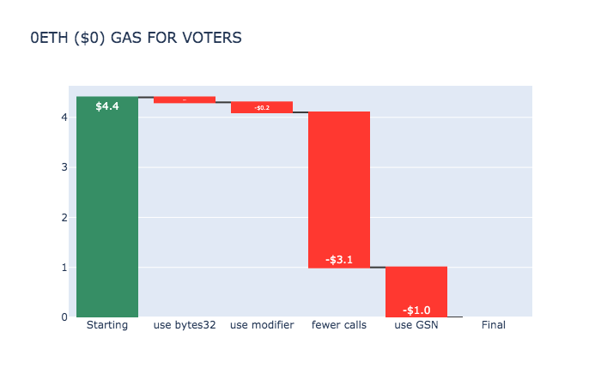
GSN (Gas Station Network)
Voters: No gas charge
Miners: Still get paid gas
3rdParty (could be GOV’T): Pays gas

Slide 15

Next Steps
Subcontracts and Subcontractors
Offboarding to Centralized Database? Long Term Storage?
Chain Wars
Authentication of User Info
Political and Legal

Slide 16
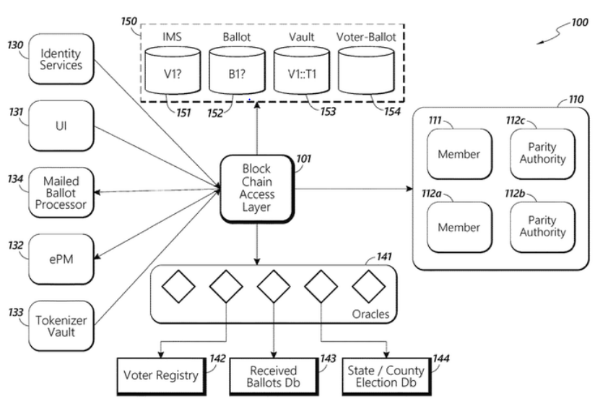
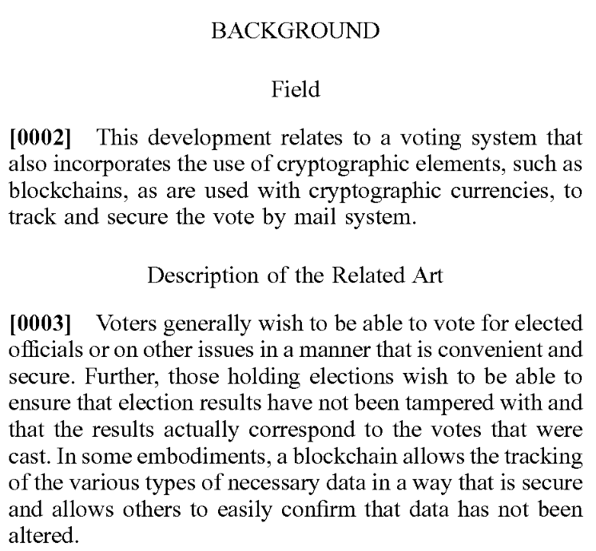
USPS PATENT FILED 8/18/20

Slide 17
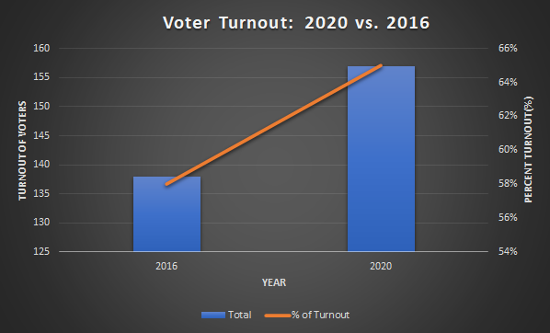

Slide 18
